Slide 1
8. 3D Object Modeling
Computer Graphics

Slide 2
Reading
Hearn & Baker, Chapter 8
Angel, Chapter 4 and 10
Watt, Chapter 2

Slide 3
Contents
Polygonal representation
CSG (Constructive Solid Geometry)
Space subdivision techniques
Implicit functions
Notes:
실시간 컴퓨터 그래픽스, 특히 게임등에서는 제한된 시간안에 필요한 장면을 그려줘야 한다. 이를 효율적으로 하기 위한 여러가지 Scene management 기법등이 중요한 이슈가 되고 있다.

Slide 4
Modeling and Representation
Creation of 3D representation
Technique/Method/Data structure
Manipulation: changing shape
Notes:
Computer graphics는 크게 세가지 분야로 나누어져 있다. Modeling, Rendering, Animation. Modeling은 3차원 object를 디자인하고 적당한 data structure로 나타내는 걸로 이번 장에서 다루게 될 내용이다. Rendering은 3차원 물체들이 카메라를 통해 보이는 장면을 그려주는 것이다. Animation은 시간에 따라 변하는 장면 또는 object들을 변화시켜 주는 것이다.
Creation: using a device such as a laser ranger or a three-dimensional digitizer. CAD interface, photographs, or video.
Method: polygon mesh, b-spline, csg method, etc.
Data structure.

Slide 5
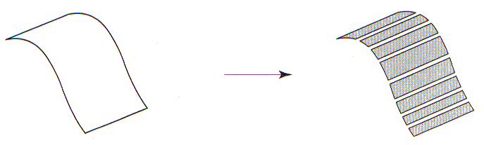
Polygonal Representation
Boundary representations
describe a 3D object as a set of surfaces that separate the object interior from the environment
cf) solid models, space-partitioning representations, …
Mesh of polygonal facets
sets of surface polygons
standard graphics objects
Curved surfaces are approximated

Slide 6
Polygonal Representation
Advantages
Straightforward
Simple shading algorithm
Disadvantages
Not user-friendly but machine-friendly
In current hardware, all kinds of surfaces are converted to polygonal representation for rendering
It is difficult to determine model accuracy

Slide 7
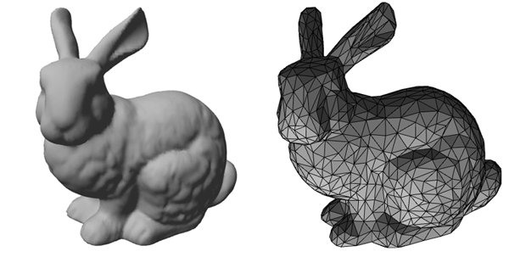
Example

Slide 8
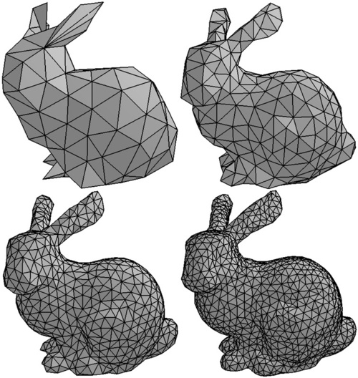
Polygon Precision

Slide 9
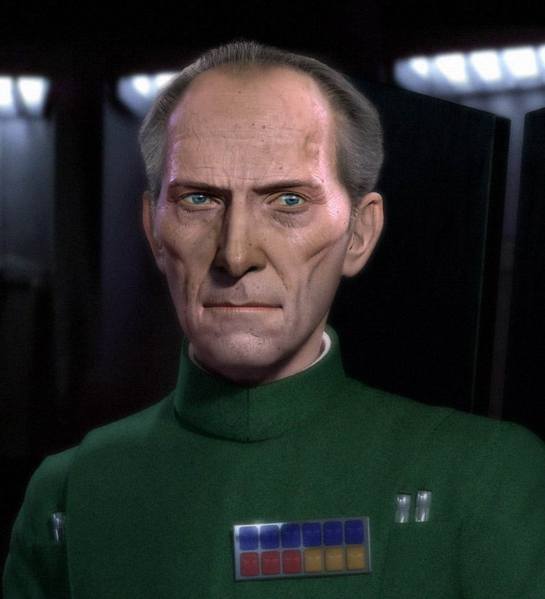
High Poly Example

Slide 10
Elements

Slide 11
Face Attributes
Triangular or not
Area
Normal to the plane containing the polygon
Coefficient (A, B, C, D) of the plane equation
Ax + By + Cz + D = 0
Is convex?
Hole?

Slide 12
Edge Attributes
Length
Whether an edge is between two polygons or between two surfaces.
Polygons on each side of the edge

Slide 13
Vertex Attributes
Polygons that contribute to the vertex
Shading or vertex normal
Texture coordinates (u,v)

Slide 14
Why Triangle
Guaranteed to be planar
Easy to find the face direction
Easy to handle
Homogeneous data structure
Faster in hardware

Slide 15
Mesh Data Structures
How to store geometry & connectivity?
Minimal set of operations
Access of vertices, edges, faces
Oriented traversal of edges of a face
Access of faces attached to an edge
Given an edge, access of its starting and/or end vertex
Given a vertex, at least one attached face or edge must be accessible
Notes:
For efficient geometry processing, it is important to specify how to store geometry and connectivity of meshes.
A variety of mesh data structures have been proposed and a number of implementations are available.
In general, when choosing a data structure, we have to take into account topological requirements as well as algorithmic requirements.
Topological requirements means which kinds of meshes need to be represented by the data structure.
For example, we need boundaries or we can assume closed meshes. We need to represent complex edges and singular vertices. We can rely on a manifold mesh. We can represent only pure triangular meshes or we can manipulate arbitrary polygonal meshes. We can represent regular, semi-regular, or irregular meshes.
Algorithmic requirements means which kinds of algorithms will be operating on the data structure.
We simply want to render the mesh or we need to modify only the geometry of the mesh or we also have to modify the connectivity. We sometimes need to associate additional data with vertices, edges or faces of the mesh. We need to have constant-time access to the local neighborhoods of vertices, edges, or faces.

Slide 16
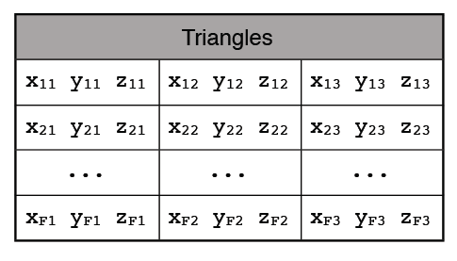
Face Set (STL)
Face:
3 positions
Connectivity information cannot be accessed explicitly
Vertices and associated data are replicated
v5
v1
v0
v4
v2
v3
Notes:
The simplest representation for triangle meshes would just store a set of individual triangles.
Some data exchange formats use this representation as a common denominator.
However, connectivity information cannot be accessed explicitly, and vertices and associated data are replicated.

Slide 17
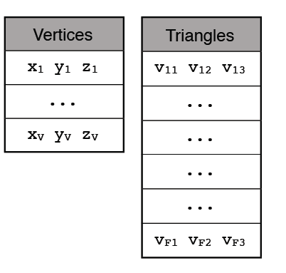
Shared Vertex (OBJ, OFF)
Vertex:
position
Face:
vertex indices
Solve replication of vertices and associated data
Simple and efficient in storage
file format
Efficient for algorithms for static data
rendering
Still, connectivity information cannot be accessed explicitly
Notes:
A shared vertex data structure stores a table of vertices and encodes triangles as triples of indices into this table.
So this representation can solve the replication of vertices and associated data.
In fact this representation is used in many file formats because it is simple and efficient in storage.
Similarly, it is efficient for certain algorithms that assume static data such as rendering.
This is still not efficient for most algorithms because connectivity information cannot be accessed explicitly.

Slide 18
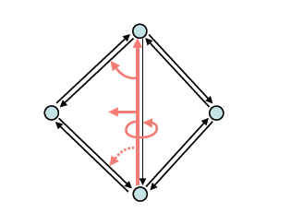
Halfedge
Vertex
Position
1 halfedge
Halfedge
1 vertex
1 face
1, 2, or 3 halfedges
Face
1 halfedge
Especially suitable for geometry processing
efficient enumeration of neighborhoods of vertices and faces
Notes:
One of the most convenient and flexible data structures in geometry processing is the halfedge data structure. This structure is able to represent arbitrary polygonal meshes
that are subsets of orientable 2-manifolds.
For each halfedge we store a reference to
the vertex it points to
its adjacent face (a zero pointer, if it is a boundary halfedge)
the next halfedge of the face or boundary (in counter-clockwise direction)
its inverse (or opposite) halfedge
the previous half-edge in the face (optional for better performance)
Additionally we store references for each face to one of its adjacent halfedges and for each vertex to one of its outgoing halfedges.

Slide 19
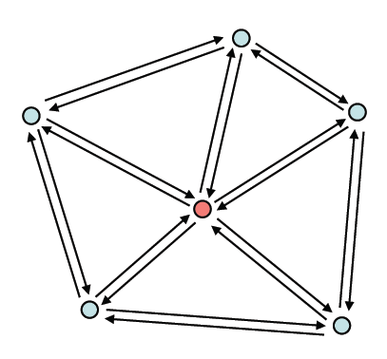
One-Ring Traversal (Halfedge)
Start at vertex
Notes:
Here, I’ll illustrate one-ring traversal of vertices of each vertex.
For a given vertex,

Slide 20
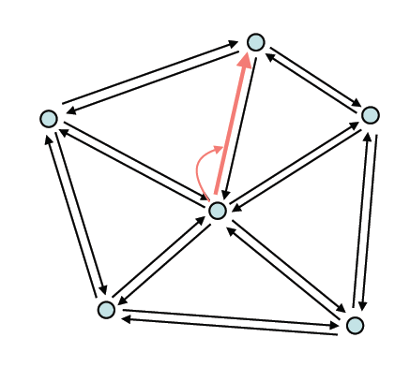
One-Ring Traversal (Halfedge)
Start at vertex
Outgoing halfedge
Notes:
With an outgoing halfedge, we can access the first neighbor vertex.

Slide 21
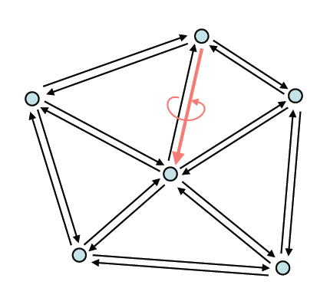
One-Ring Traversal (Halfedge)
Start at vertex
Outgoing halfedge
Opposite halfedge
Notes:
Then, we take the opposite halfedge of the outgoing halfedge.

Slide 22
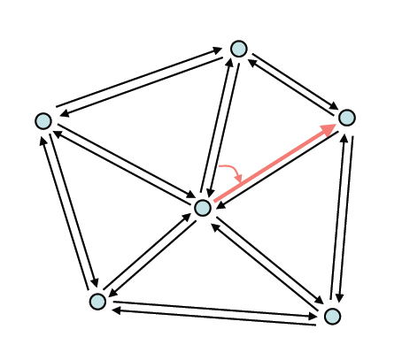
One-Ring Traversal (Halfedge)
Start at vertex
Outgoing halfedge
Opposite halfedge
Next halfedge
Notes:
Next, we follow its next halfedge in the counter-clockwise direction.
From this halfedge, we can access the second neighbor vertex.

Slide 23
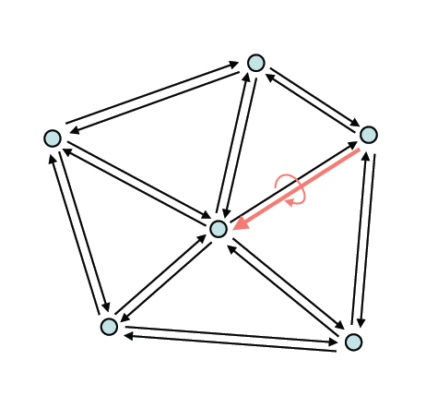
One-Ring Traversal (Halfedge)
Start at vertex
Outgoing halfedge
Opposite halfedge
Next halfedge
Opposite
Notes:
Again, we take the opposite halfedge.

Slide 24
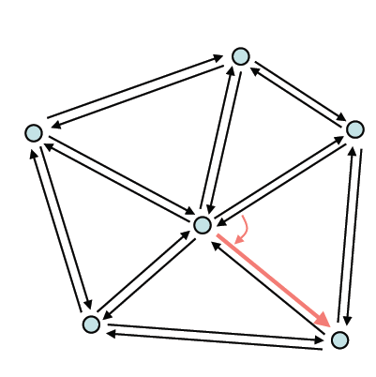
One-Ring Traversal (Halfedge)
Start at vertex
Outgoing halfedge
Opposite halfedge
Next halfedge
Opposite
Next
…
Notes:
By repeating this process, we can access all neighbor vertices of each vertex.

Slide 25
Halfedge-Based Libraries
CGAL
www.cgal.org
Computational geometry
Free for non-commercial use
OpenMesh
www.openmesh.org
Mesh processing
Free, LGPL licence
Notes:
Although the description of a halfedge data structure is straightforward, its implementation is not.
So it is strongly recommendable to use one of full featured, publicly available mesh
libraries.
CGAL and OpenMesh are ones of widely used mesh libraries.
They are based on a halfedge data structure.
Rich foundation of algorithms of CGAL is strongly biased by computational geometry with focus on robust and exact algorithms.
CGAL has a wide user base and a number of research institutions actively contribute to its development.
In contrast, OpenMesh is highly specialized on efficient processing of surface
meshes based solely on halfedge data structures. It takes over some concepts of CGAL.
It is much more focused on requirements of modeling with polygonal meshes and provides a set of standard geometry processing algorithms, like mesh smoothing, decimation, etc.

Slide 26
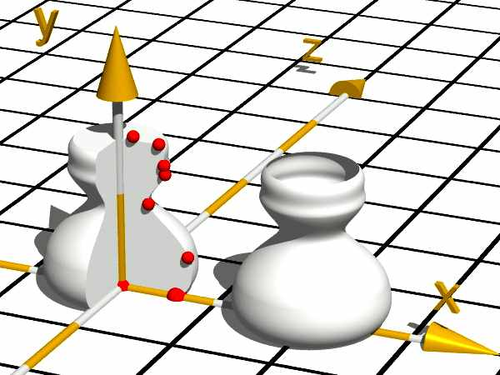
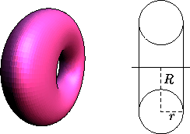
Sweep Representation
Useful for constructing 3D objects that possess translational, rotational, or other symmetries
Specify a 2D shape and a sweep that moves the shape through a region of space
Surface of revolution
Circle cross section
Non-circle cross section

Slide 27
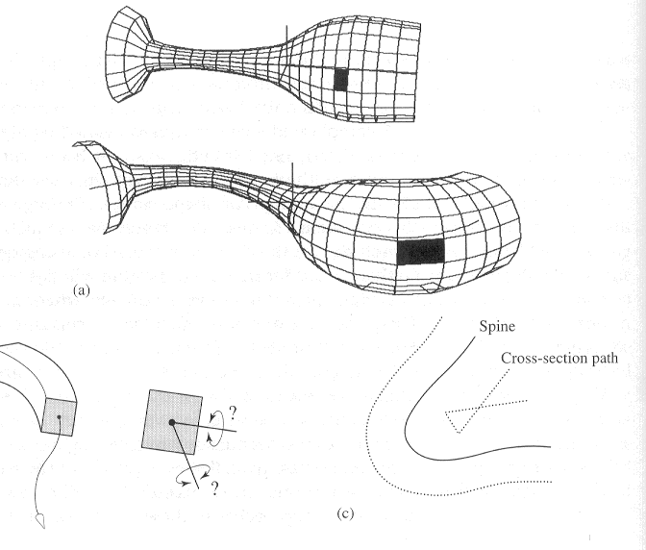


Sweep Representation
Cross section sweeping
Polygon size
Cross section orientation
Self intersection

Slide 28
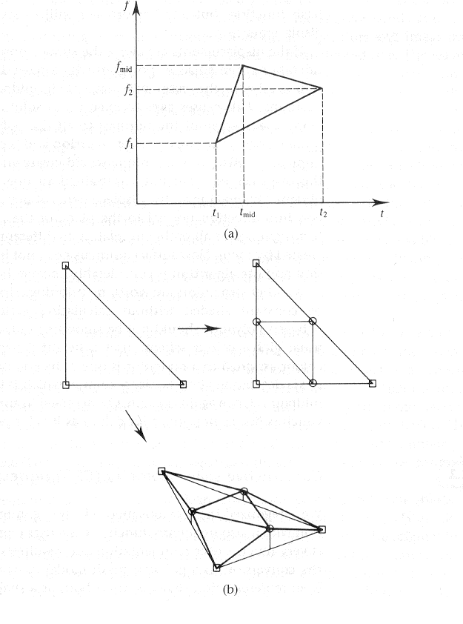
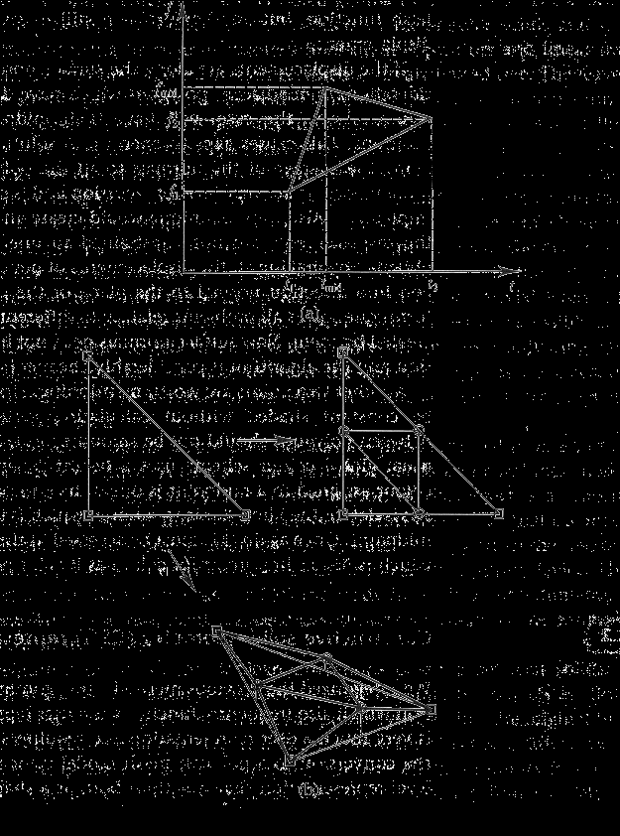
Procedural Polygon Mesh Objects
Fractal Objects
Term coined by Benoit Mandelbrot
Tendency towards self-similarity

Slide 29
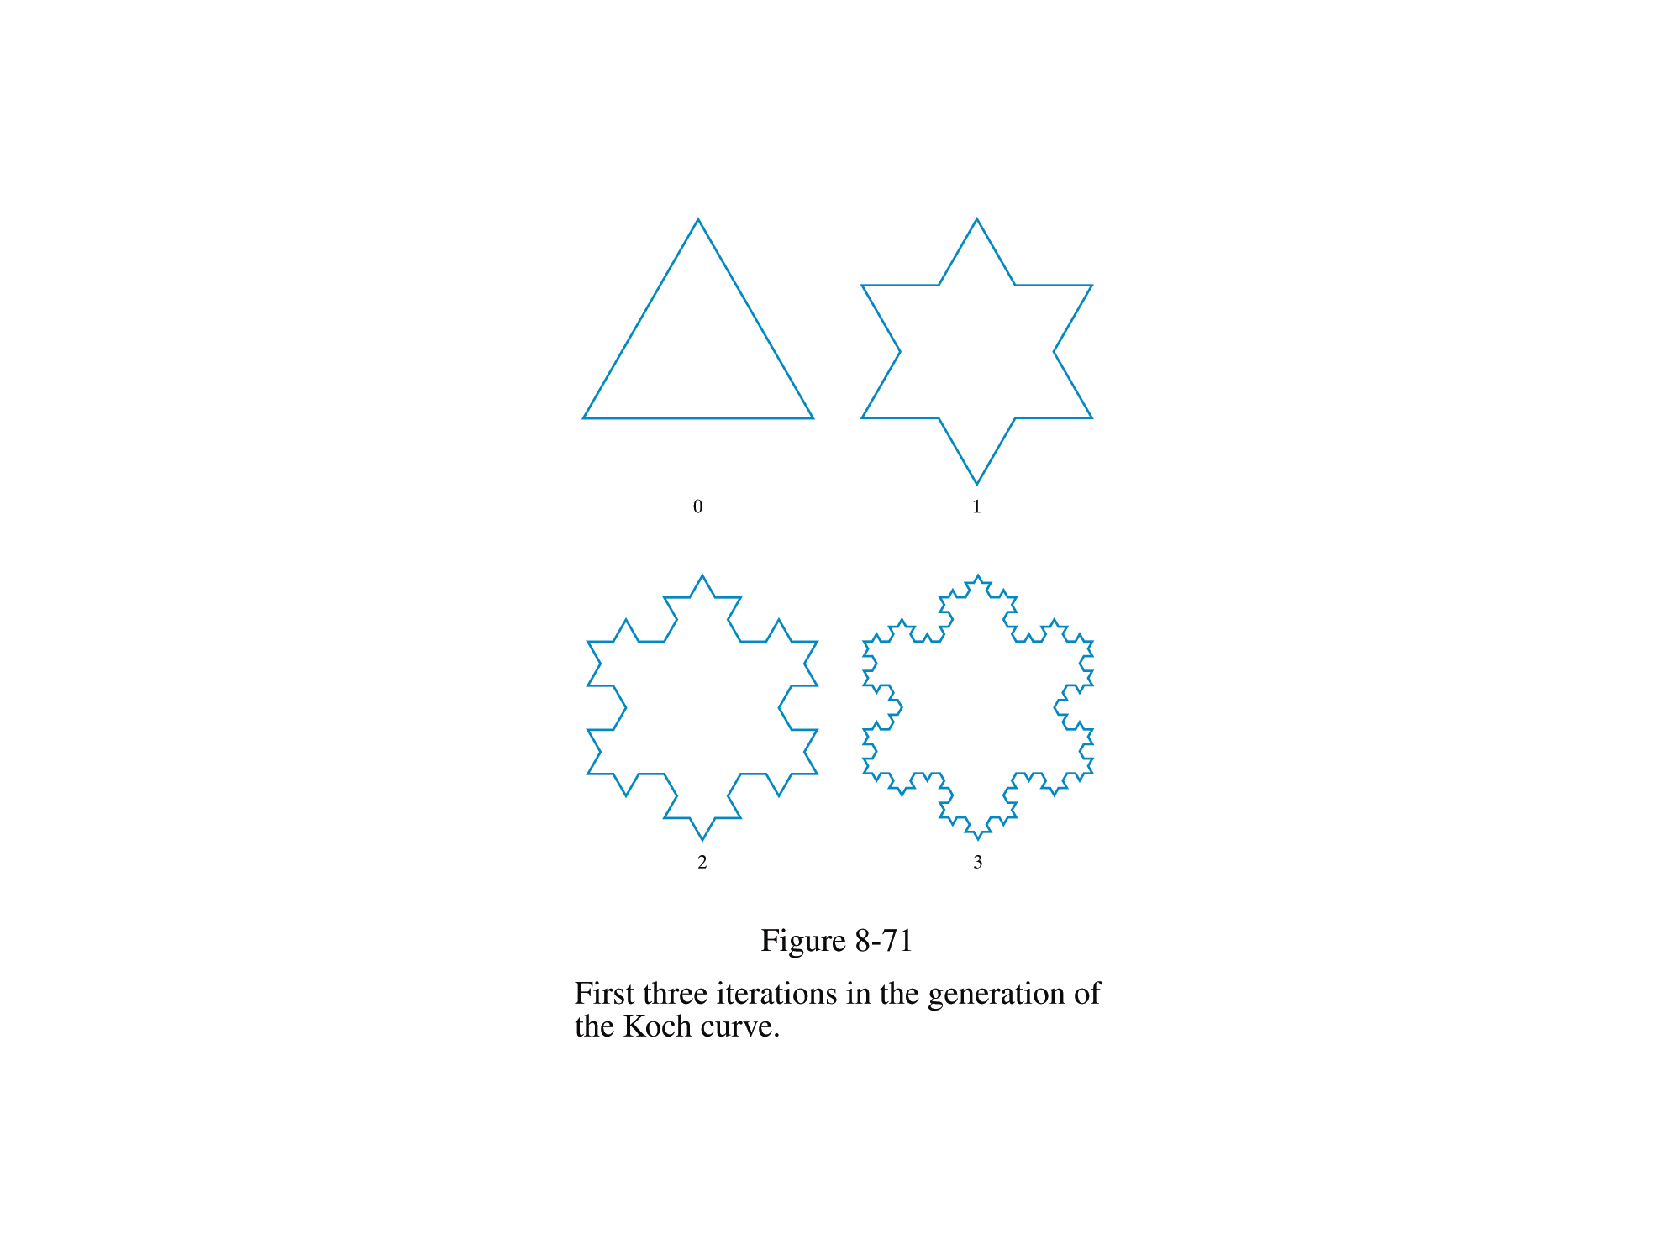
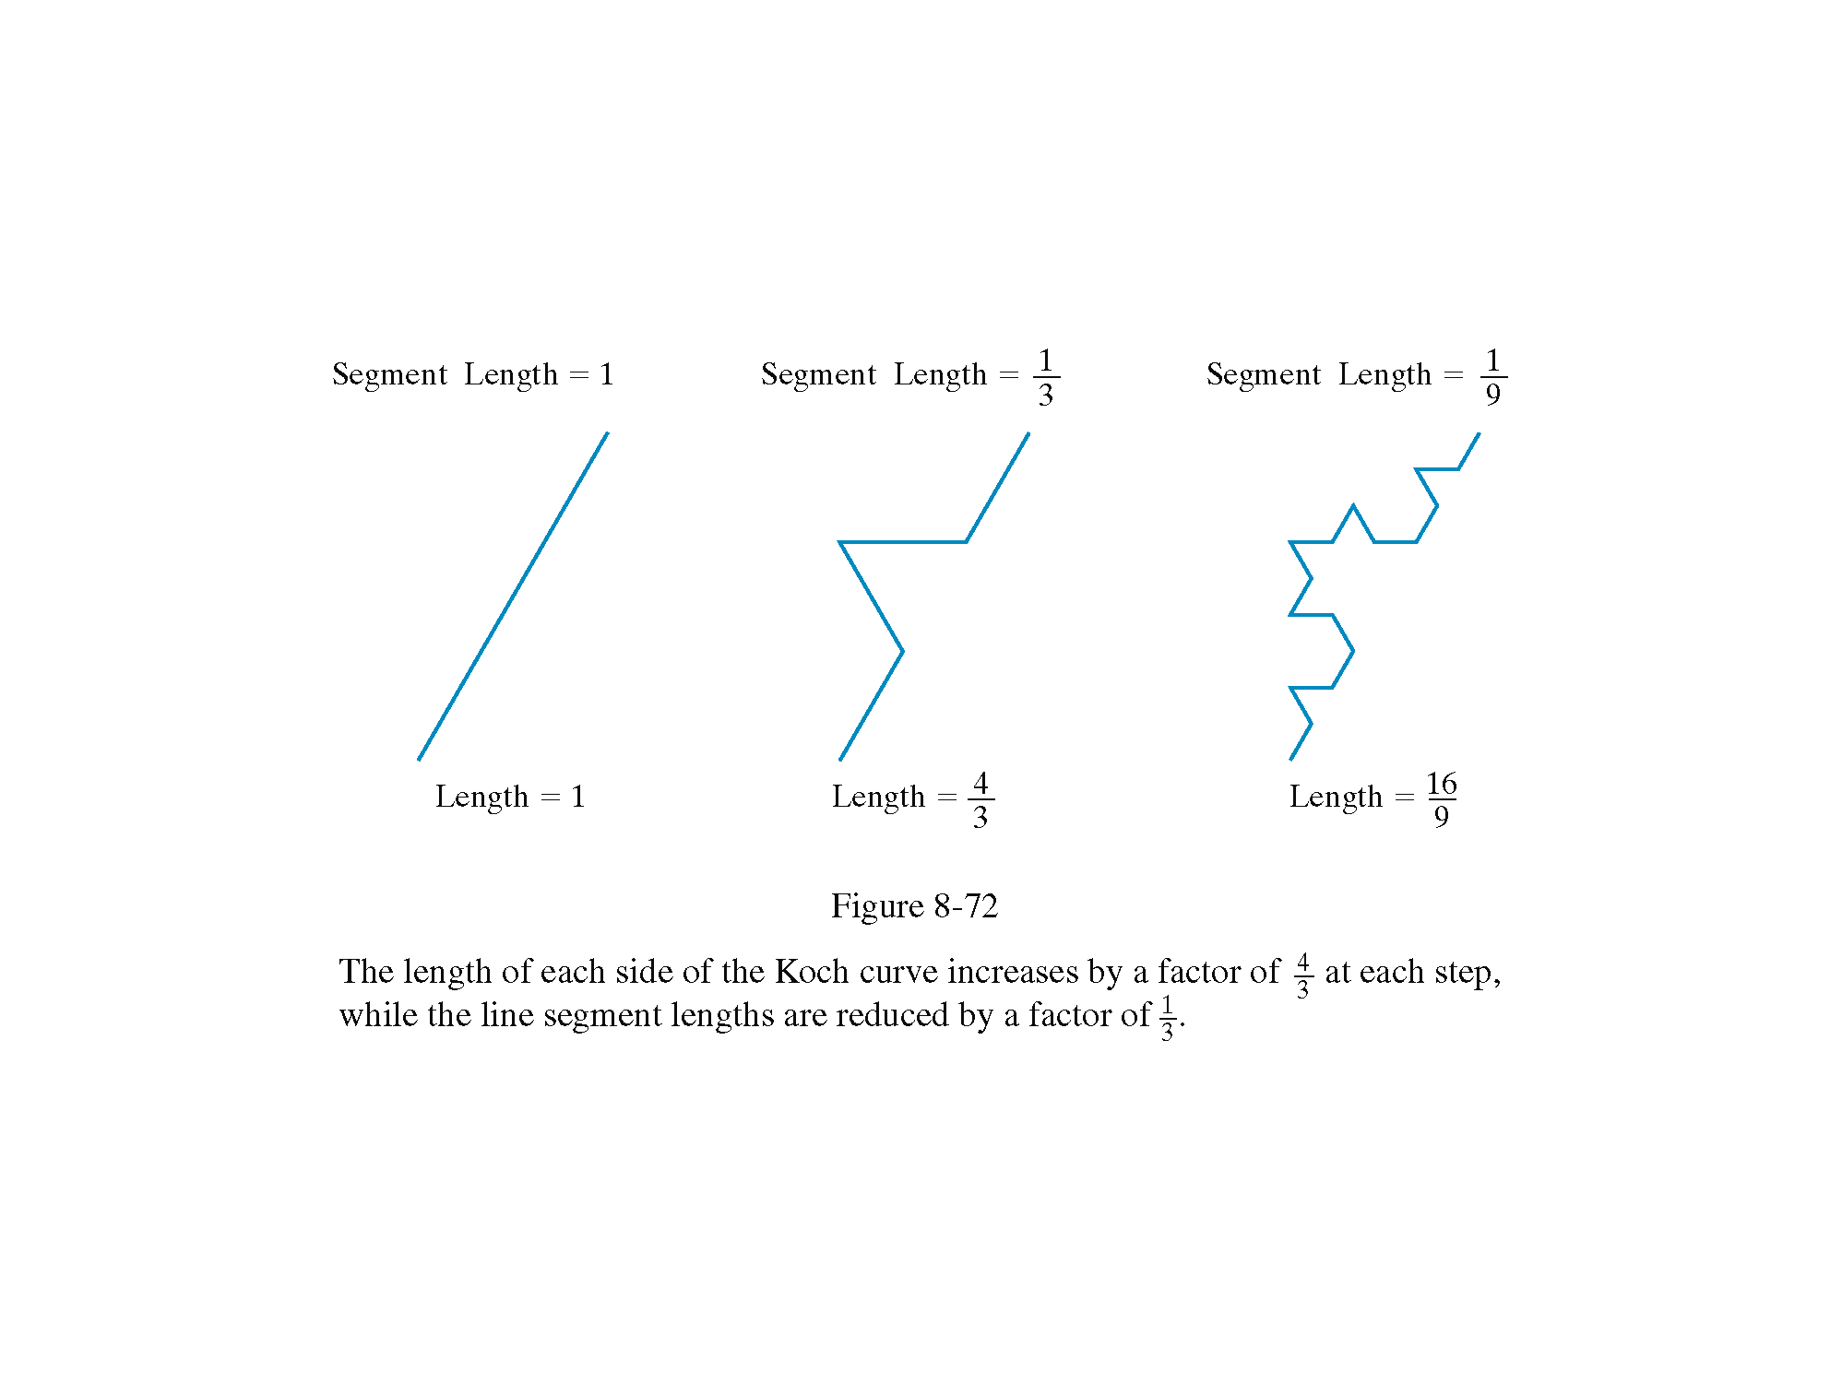
Fractal Example: The Koch Snowflake

Slide 30
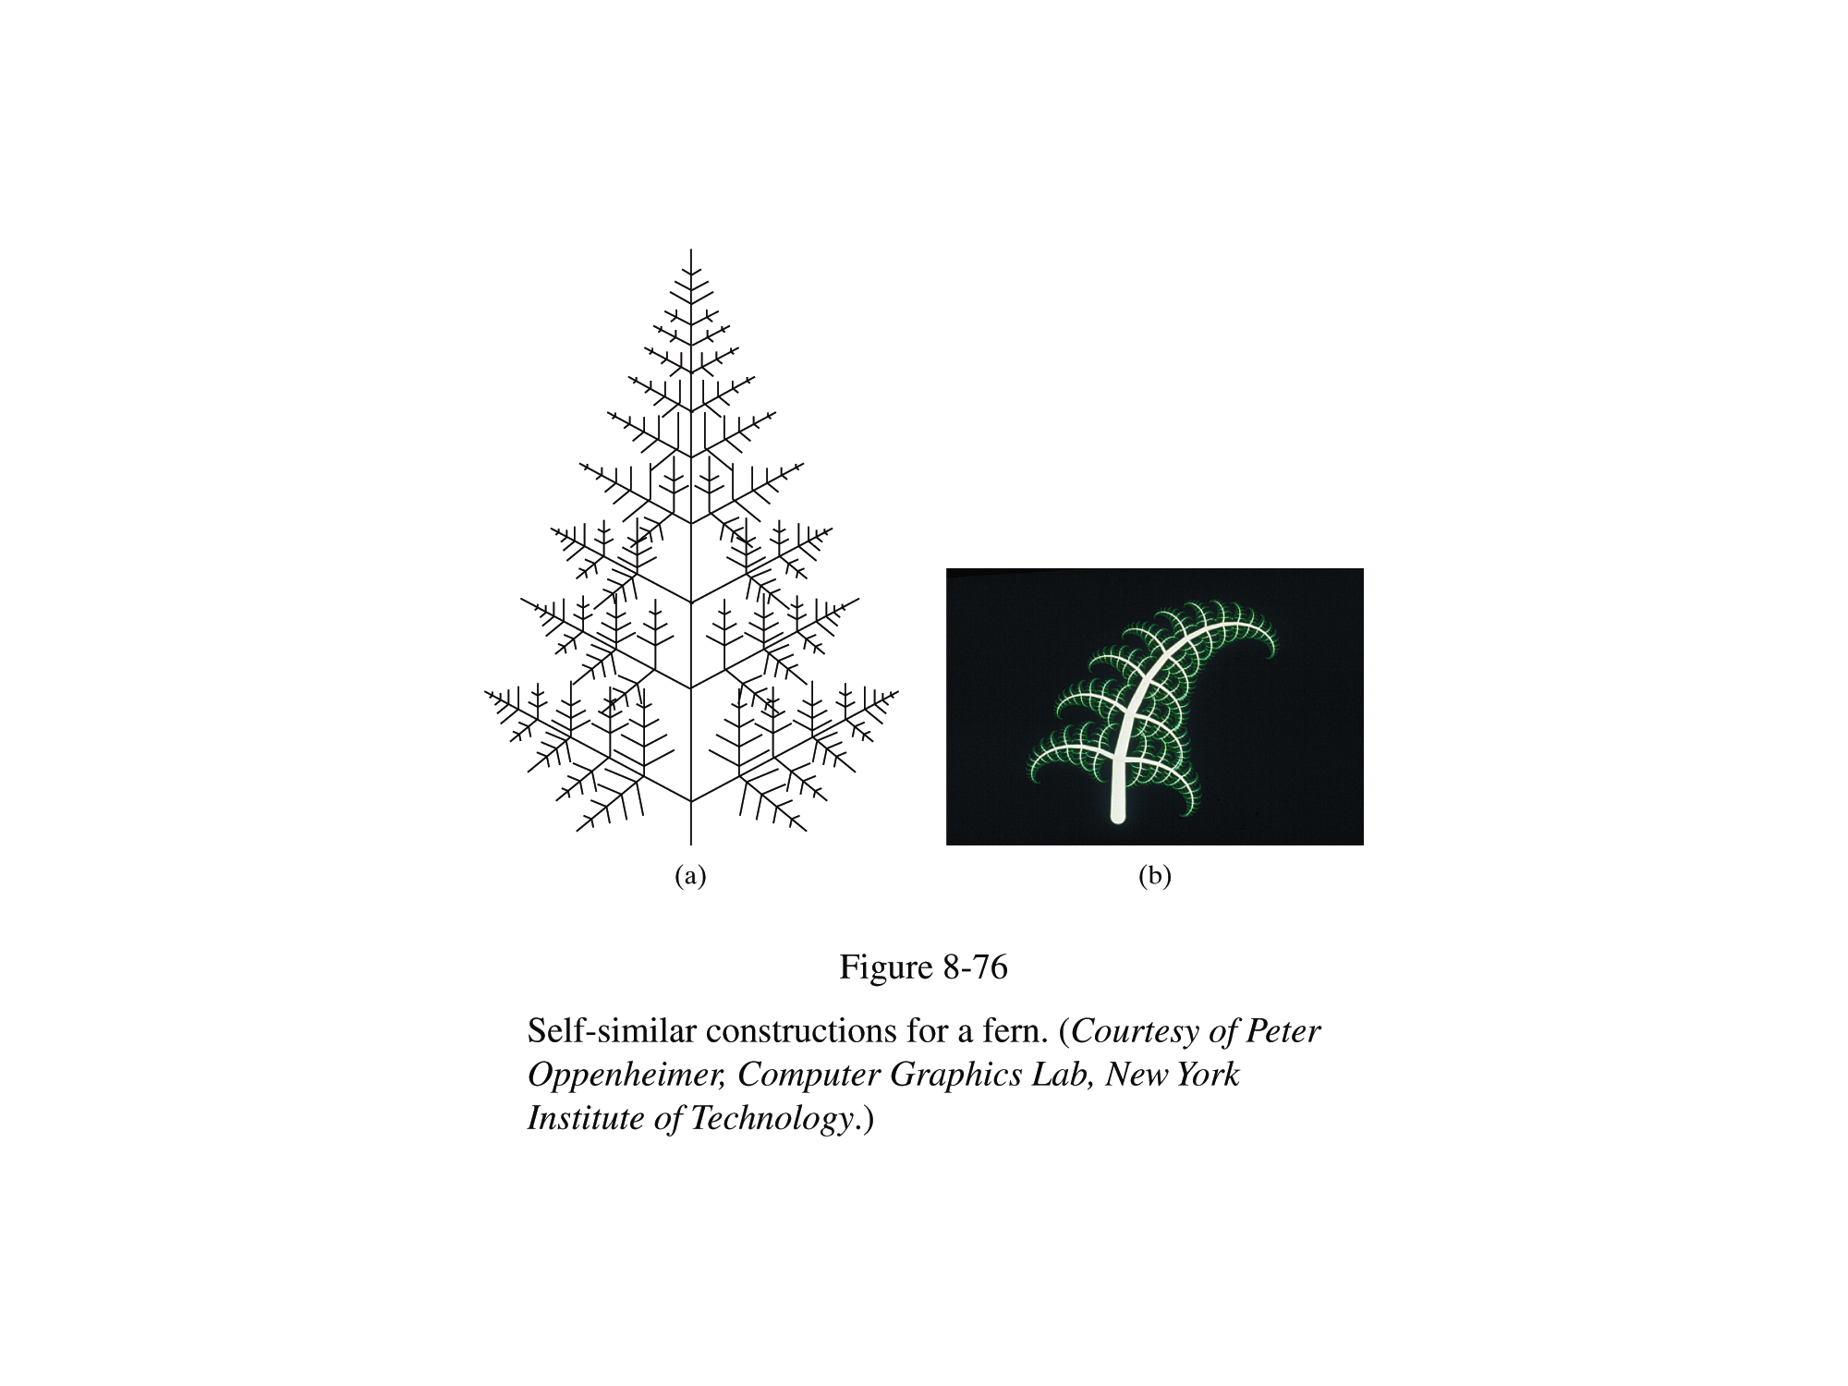
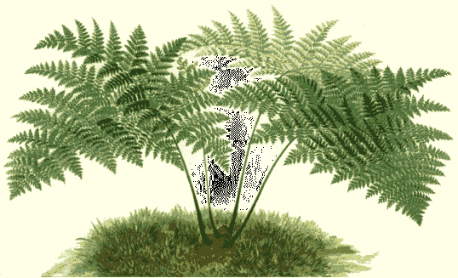
Fractal Example: Fern

Slide 31
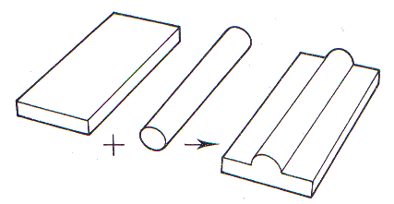
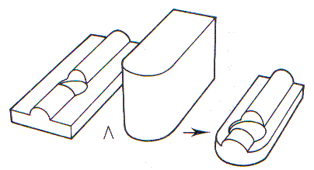
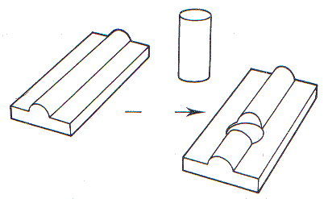
CSG (Constructive Solid Geometry)
Create a new object by applying a set operation (the union, intersection, or difference operation) to two specified solids
very user friendly modeling technique

Slide 32
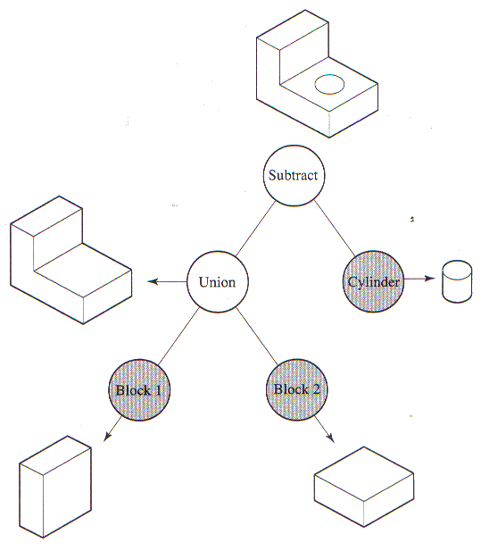
CSG Tree

Slide 33
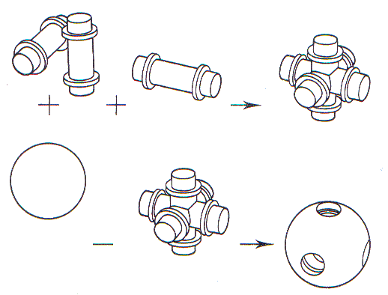
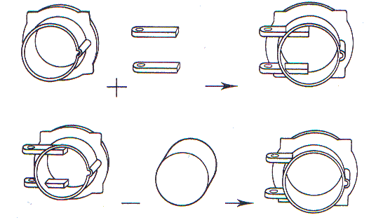
CSG – Complex parts

Slide 34
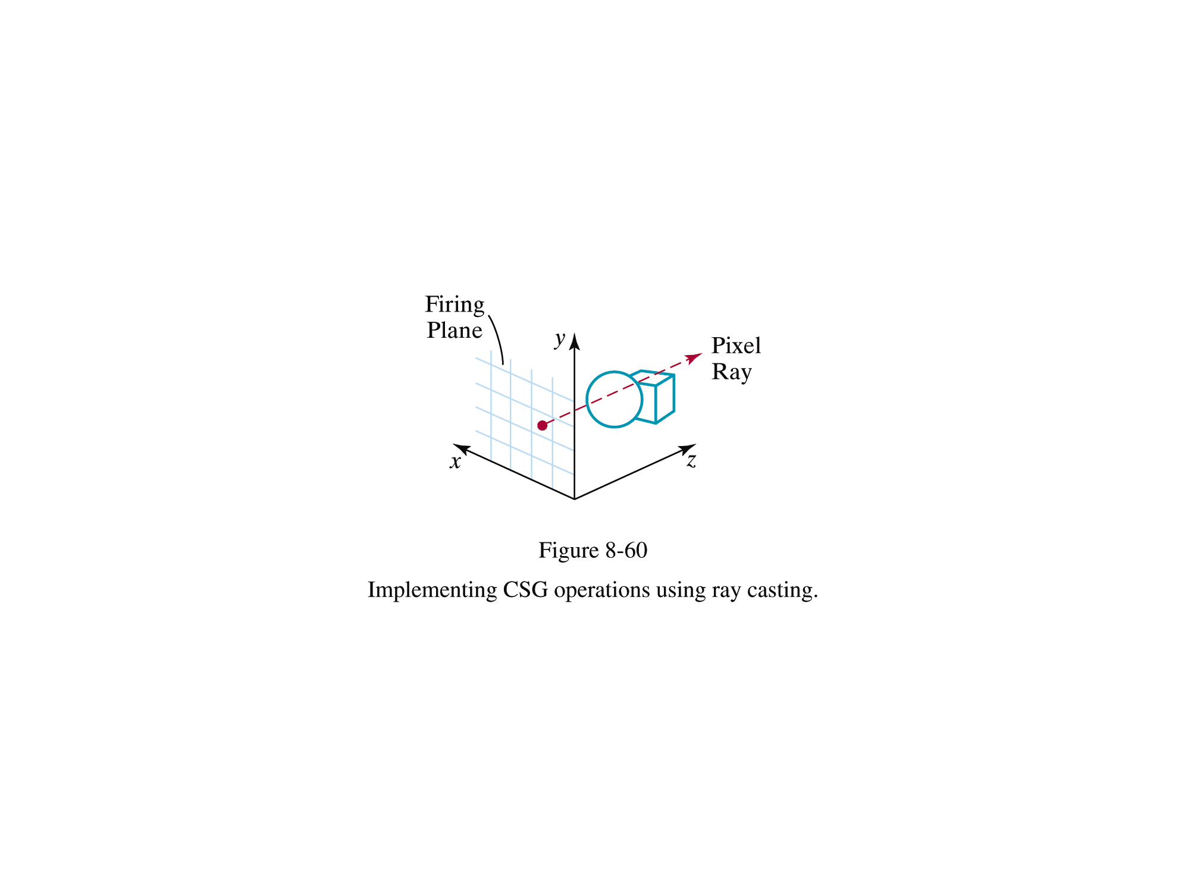
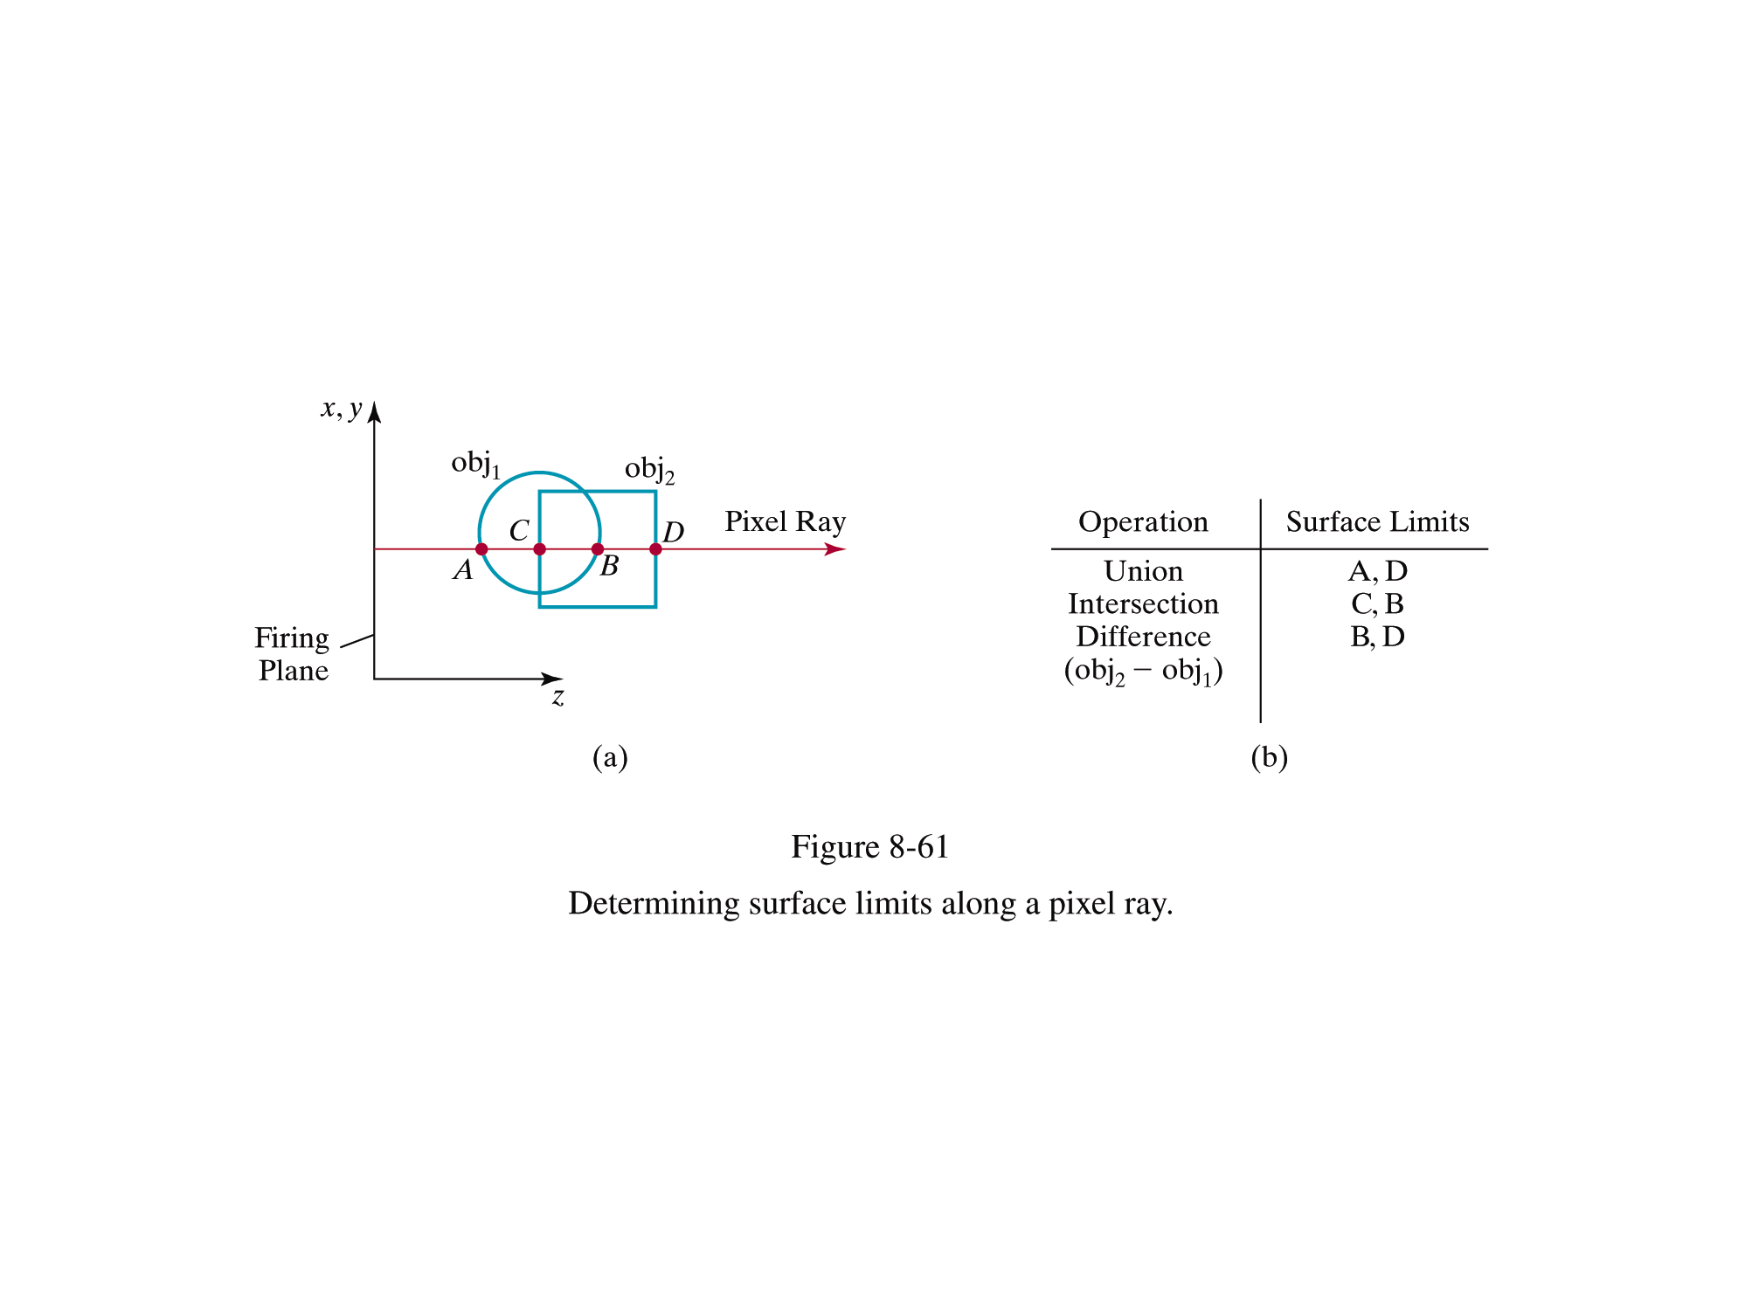
Drawbacks of CSG
Difficulty in rendering
Conversion into Polygon Mesh :
Not straightforward.
Ray casting : in-out classification
Difficulty in representing surface details
Ex) Blending surfaces
Use underlying boundary representation

Slide 35
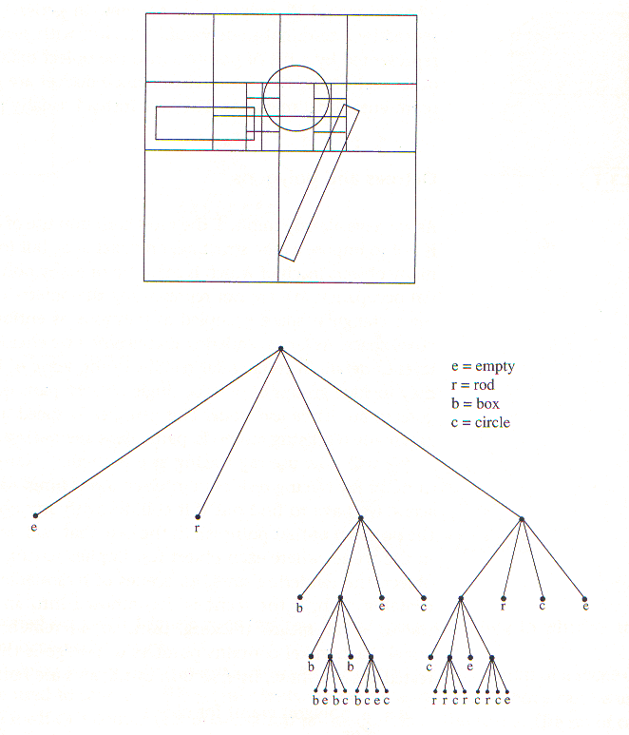
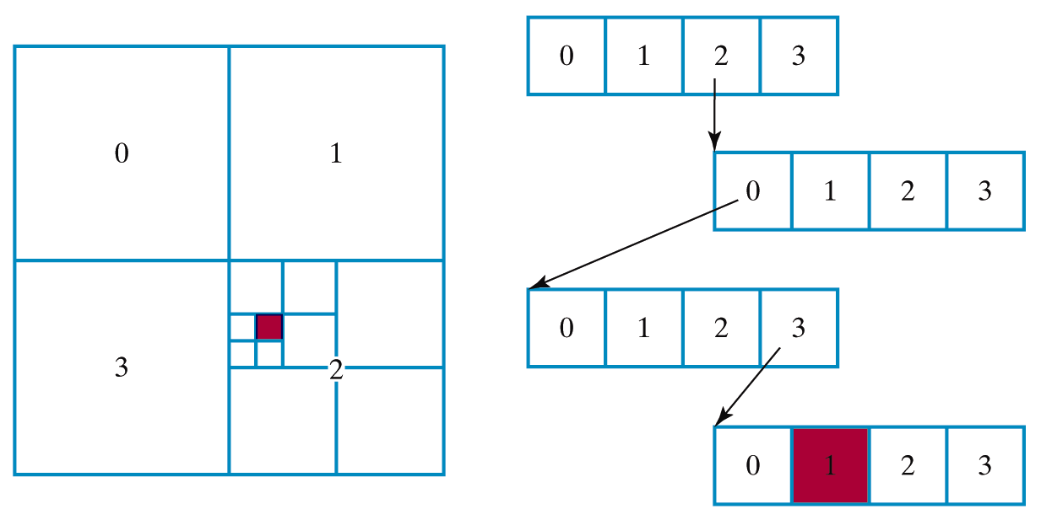
Space Subdivision: Quadtree
Hierarchical decomposition of the scene area
http://www.cs.wustl.edu/~suri/cs506/projects/quad.html

Slide 36
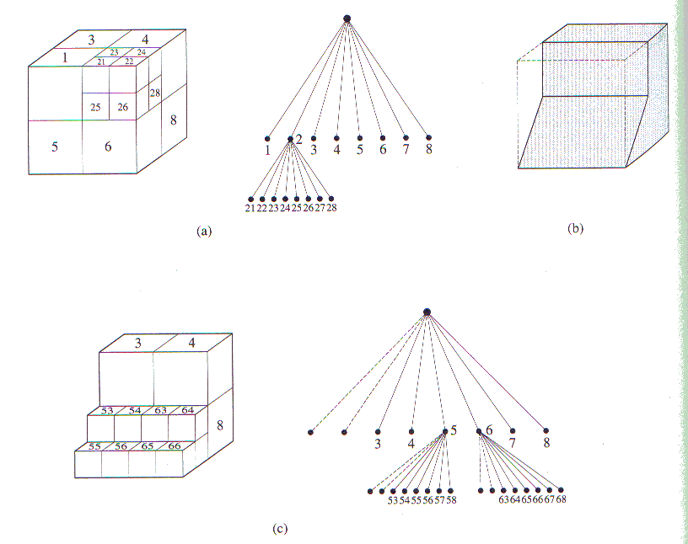
Octree

Slide 37
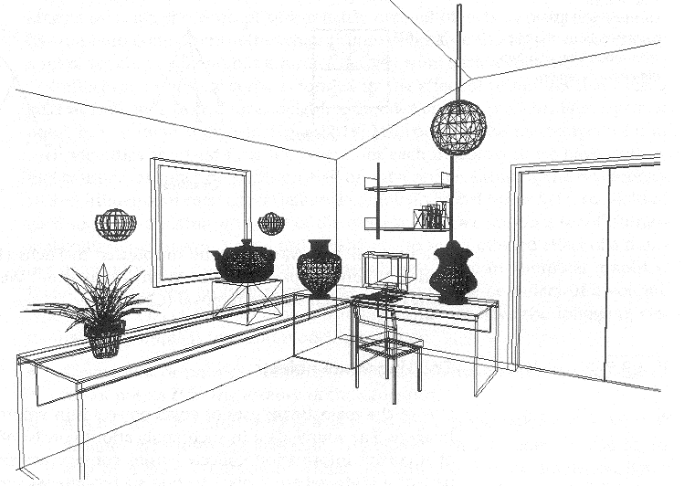
Few Objects, High Polygon Count
Not suitable for octree representation
High octree depth

Slide 38
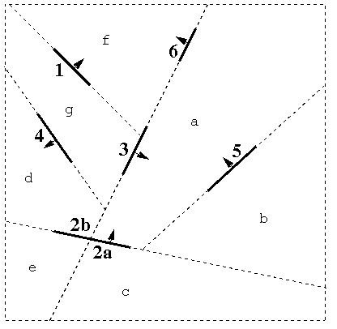
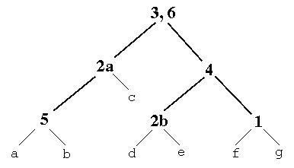
BSP Trees
Each node corresponds to a region of space

Slide 39
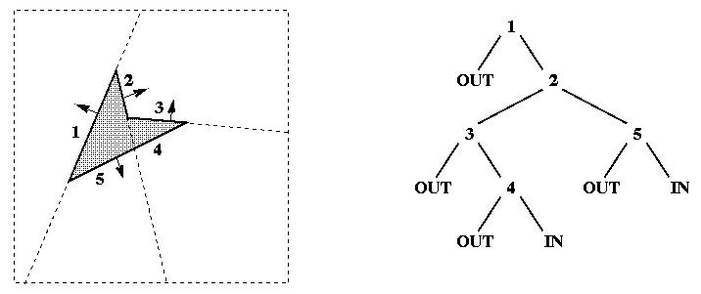
Representation of Polygons

Slide 40
BSP Tree
Partitioning plane
Any object on one side of a plane cannot intercept any object on the other side.

Slide 41
BSP Tree
One group of objects is determined to be closer to the view point than the other group.
http://symbolcraft.com/graphics/bsp/
View point

Slide 42
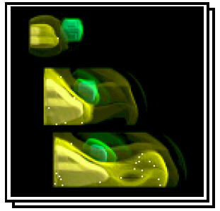
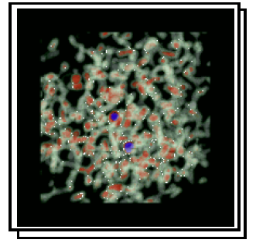
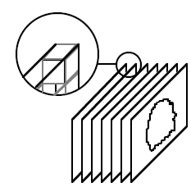
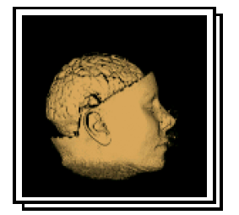
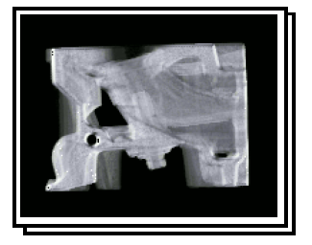
Voxel Objects
In Volume Rendering

Slide 43
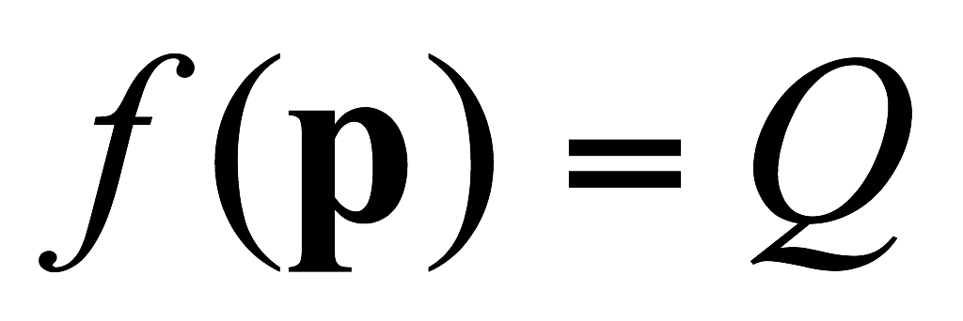
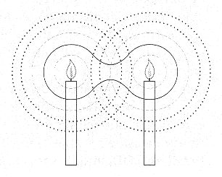
Implicit Surface
A set of points satisfying an equation
Function f is analogous to the total intensity of lights from candals.

Slide 44
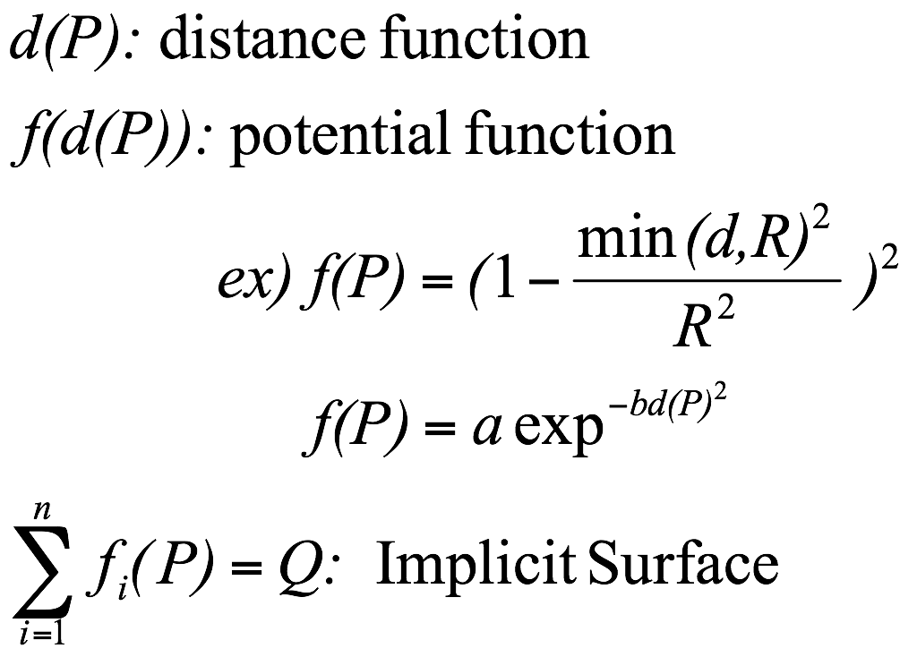
Implicit Surface
Soft object, Blobby object, Metaball

Slide 45
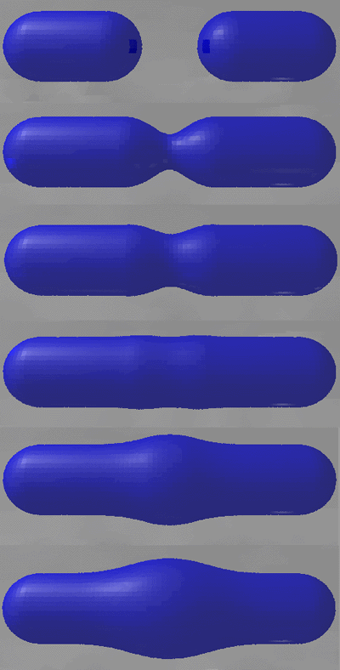
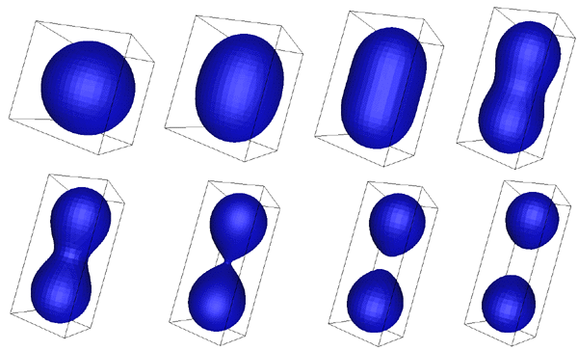
Implicit Surface

Slide 46
In Practice

Slide 47
Geometry Specification
Primitives
Triangles
Lines
Points
Quads
Hardware compatibility
Vertex specifications
Including vertex attributes such as color, texture coordinates, …
Primitive specifications
Composing vertices to make primitives

Slide 48
Vertex Specification
Vertex Stream
The set of data sent to graphics pipelines
Vertex attributes
OpenGL support various way to send vertices (and attributes) to pipeline
Vertex Array Object (VAO)
Vertex Buffer Object (VBO)
Resides in hardware memory
Much faster for rendering

Slide 49
Major Terms
Buffers
Hardware storage
Containing Data
Vertex Buffer Objects
Buffers
Buffers for vertex attributes
Vertex Array
Connection between buffers to Graphics Pipeline
Note: Rendering often needs many buffers at a time

Slide 50
Vertex Buffer Object
GPU
vboID1
Buffer id:1
My Vertex Data
GenBuffers
Vertex Shader
BindBuffer
BufferData
Attr0
Attr1
GenBuffers
vboID2
Buffer id:2
BindBuffer
My Vertex Color
BufferData

Slide 51
Vertex Buffer Array
GenVertexArrays
BindVertexArray
GPU
vaID
vboID1
Buffer id:1
EnableVertexAttribArray
BindBuffer
Vertex
Array
Id: 1
Vertex Shader
VertexAttribPointer
Attr0
Attr0
Attr1
Attr1
vboID2
Buffer id:2
EnableVertexAttribArray
BindBuffer
VertexAttribPointer

Slide 52
Rendering
UseProgram
BindVertexArray
GPU
vaID
Buffer id:1
Rendering
Vertex
Array
Id: 1
Vertex Shader
Attr0
Attr0
Attr1
Attr1
Buffer id:2

Slide 53
Source Code Example
Global Variables
GLuint trangleVBO=0;
Gluint vertexArrayID = 0;
VertexArray Initialization
glGenVertexArrays(1, &vertexArrayID);
Buffer Initialization
float data[] = {-1.0, -1.0, 0.0, 1.0, -1.0, 0.0, 0.0, 1.0, 0.0};
glGenBuffers(1, &triangleVBO);
glBindBuffer(GL_ARRAY_BUFFER, triangleVBO);
glBufferData(GL_ARRAY_BUFFER, sizeof(data), data, GL_STATIC_DRAW);

Slide 54
Source Code Example
Buffer to VertexArray connection
glBindVertexArray(vertexArrayID);
glBindBuffer(GL_ARRAY_BUFFER, triangleVBO);
glEnableVertexAttribArray(0);
glVertexAttribPointer(0, 3, GL_FLOAT, GL_FALSE, 0, 0);
Rendering (at each frame)
glBindVertexArray(vertexArrayID);

Slide 55
Primitive Assembly

Slide 56
Primitive Assembly
Most simple method
glDrawArrays( GL_TRIANGLES, 0, 3 );
Starting from the first (0-th) vertex, draw triangles using three vertices in vertex attribute
Problem
Duplicated vertices
Solution
Drawing using vertex ID
v5
v1
v0
v4
v2
v3

Slide 57
Shared Vertex (OBJ, OFF)
Vertex:
position
Face:
vertex indices
Solve replication of vertices and associated data
Simple and efficient in storage
file format
Efficient for algorithms for static data
rendering
Still, connectivity information cannot be accessed explicitly
Notes:
A shared vertex data structure stores a table of vertices and encodes triangles as triples of indices into this table.
So this representation can solve the replication of vertices and associated data.
In fact this representation is used in many file formats because it is simple and efficient in storage.
Similarly, it is efficient for certain algorithms that assume static data such as rendering.
This is still not efficient for most algorithms because connectivity information cannot be accessed explicitly.

Slide 58
Primitive Assembly
Using element array buffer
The same as the buffers used for vertices
Containing vertex index for drawing

Slide 59
Primitive Assembly
Initialization
ushort pindices[3];
pindices[0] = 0;
pindices[1] = 1;
pindices[2] = 2;
glGenBuffers(1, &IndexVBOID);
glBindBuffer(GL_ELEMENT_ARRAY_BUFFER, IndexVBOID);
glBufferData(GL_ELEMENT_ARRAY_BUFFER, sizeof(ushort)*3, pindices, GL_STATIC_DRAW);
Rendering
glBindBuffer(GL_ELEMENT_ARRAY_BUFFER, IndexVBOID);
glDrawElements(GL_TRIANGLES, 3, GL_UNSIGNED_SHORT, 0);
Draw three indexed vertices to compose TRIANGLES

Slide 60
Using GLM & vector
Typical choice for vertex data
vec3 // good container for 3-vectors
std::vector // better choice for array
Example
std::vector<glm::vec3> vertices;
vertices.push_back( glm::vec3( -1.0, -1.0, 0.0 ) );
vertices.push_back( glm::vec3( 1.0, -1.0, 0.0 ) );
vertices.push_back( glm::vec3( 0.0, 1.0, 0.0 ) );
…
glBufferData(GL_ARRAY_BUFFER, sizeof(glm::vec3)*vertices.size(), vertices.data(), GL_STATIC_DRAW);

Slide 61
Using GLM & vector
Element Array Buffer
Usually use u16vec3 (3-vector for unsigned short)
Therefore, std::vector<glm::u16vec3> indices;
indices.push_back( glm::u16vec3(0,1,2) );
…
glBufferData(GL_ELEMENT_ARRAY_BUFFER, sizeof(glm::u16vec3)*indices.size(), indices.data(), GL_STATIC_DRAW);

Slide 62
Assignment #1
Draw a red circle
Hint (For using primitive of GL_TRIANGLES)
Center vertex: (0,0,0)
Say that it is the first (0-th) vertex
Boundary vertex position r*glm::vec3(cos(theta), sin(theta),0) where 0≤theta<2*PI
Vertex indices for a triangle: (0, k, k+1)
If k==n, (0, k, 1)

